Slide 1

Quantifying Churn Risk in Banking: A Comparative Study of Predictive Models
Anmol Anchala
Raheela Charania
Emmanuel Wediko
Notes:
Breaking Up with Banks: A Churn Story Told in Regressions

Slide 2
Background
What is customer churn?
Why does it matter in banking?
Insight from 2019
Solution Approach
Group 9
Mercer University
2/12
Notes:
· What is Customer Churn?: Customer Churn is Customers discontinuing a company's services, leading to account closure.
· Why it Matters in Banking?: Retaining customers is more cost-effective than acquiring new ones, High churn impacts profitability and reputation, increasing competition from non-traditional providers like fintech and big tech firms like SOFI which is one of the biggest fintech out there now.
· The 2019 Insight: in 2019, it was observed that 66.8% of banking customers have used or plan to use non-traditional accounts within three years.
· Solution Approach: Leverage data analysis to identify at-risk customers, use insights to proactively offer incentives, retaining customers and driving profitability.

Slide 3
Business Problem
Improve customer retention, financial performance, and bank reputation
Develop a predictive model to identify banking customers at risk of churning
Reduce customer churn rate by offering targeted incentives
Group 9
Mercer University
1/12
Notes:
Develop a predictive model to identify banking customers at risk of churning: This involves building a data-driven model to analyze customer behavior and flag those likely to leave. Because in banking (or any business honestly) we do not want to lose clients. This model will use historical data and key predictors to classify customers based on churn risk.
· Reduce customer churn rates by offering targeted incentives: The ultimate goal is to intervene before customers leave by identifying the reasons behind their dissatisfaction and offering personalized solutions or rewards to retain them. And a customer will feel more special if a tactic is created for him personally.
· Improve customer retention, financial performance, and bank reputation: By reducing churn, the bank ensures a stable customer base, increases profitability by avoiding the high costs of acquiring new customers, and enhances its reputation as a customer-centric institution.

Slide 4
Data Dictionary
Exited
Points Earned
CreditScore
Balance
Geography
Gender
NumOfProducts
Whether or not the customer left the bank. 0 = customer stays. 1 = customer leaves.
The points earned by the customer for using credit card
Can have an effect on customer churn, since a customer with a higher credit score is less likely to leave the bank.
Also a very good indicator of customer churn, as people with a higher balance in their accounts are less likely to leave the bank compared to those with lower balances.
A customer’s location can affect their decision to leave the bank.
It's interesting to explore whether gender plays a role in a customer leaving the bank.
Refers to the # of products that a customer has purchased through the bank.
Group 9
Mercer University
3/12

Slide 5
EDA : Descriptive Stats
 | Mean | Standard Deviation
Age | 37.74 | 8.78
Points Earned | 605.92 | 225.87
Balance | 76426.07 | 62417.82
Credit Score | 650.66 | 96.13
NumOfProduct | 1.52 | 0.54
Group 9
Mercer University
8/12
Notes:
Keep in mind the variables with the stars. Will return in the end

Slide 6
EDA: Descriptive Stats
Gender
Male: 55%
Female: 45%
Has Credit Card
No (0): 29%
Yes (1): 71%
Card Type
Diamond: 25%
Gold: 25%
Platinum: 25%
Silver: 25%
Exited
No (0): 80%
Yes (1): 20%
Group 9
Mercer University
7/12

Slide 7
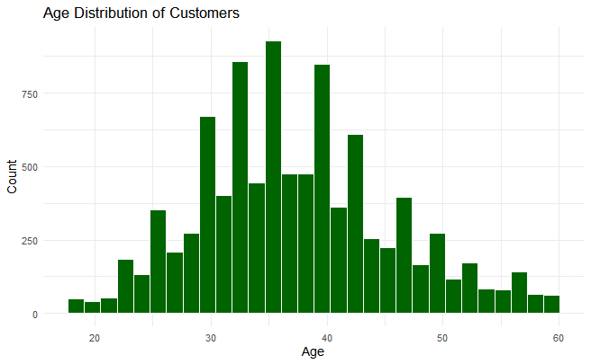
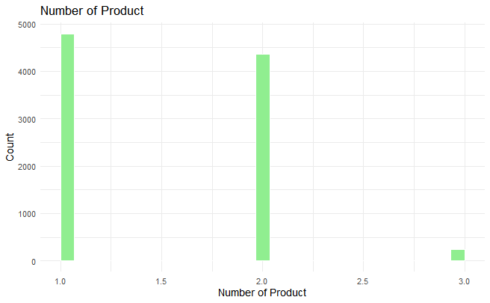
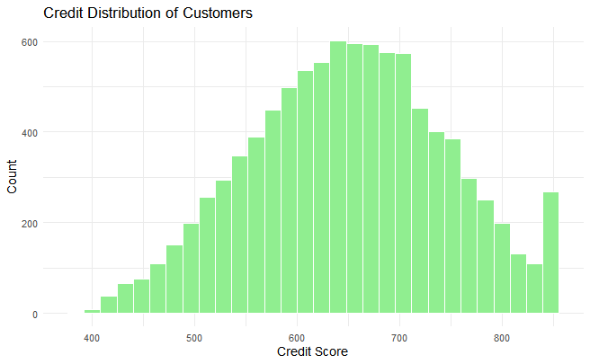
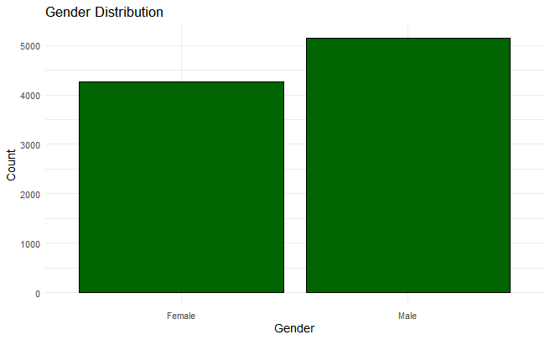
EDA: Exploratory Stats
Group 9
Mercer University
10/12
Notes:
We ran some exploratory stats to understand data distribution, to identify any outliers or missing data.

Slide 8
Data Preparation
Data cleaning
No missing values
Removed outliers
Data partitioning
70% traning
30% testing
Standardization
Z- score
Group 9
Mercer University
6/12
Notes:
Its best practice to split the dataset 70-30 %
Its also best practice to use Z-score standardization (Most commonly used in the industry)
Oversampling: duplicate same records to add more records from the split that has the most. Since our dataset is on the smaller side. Under sampling will have made us lose records

Slide 9
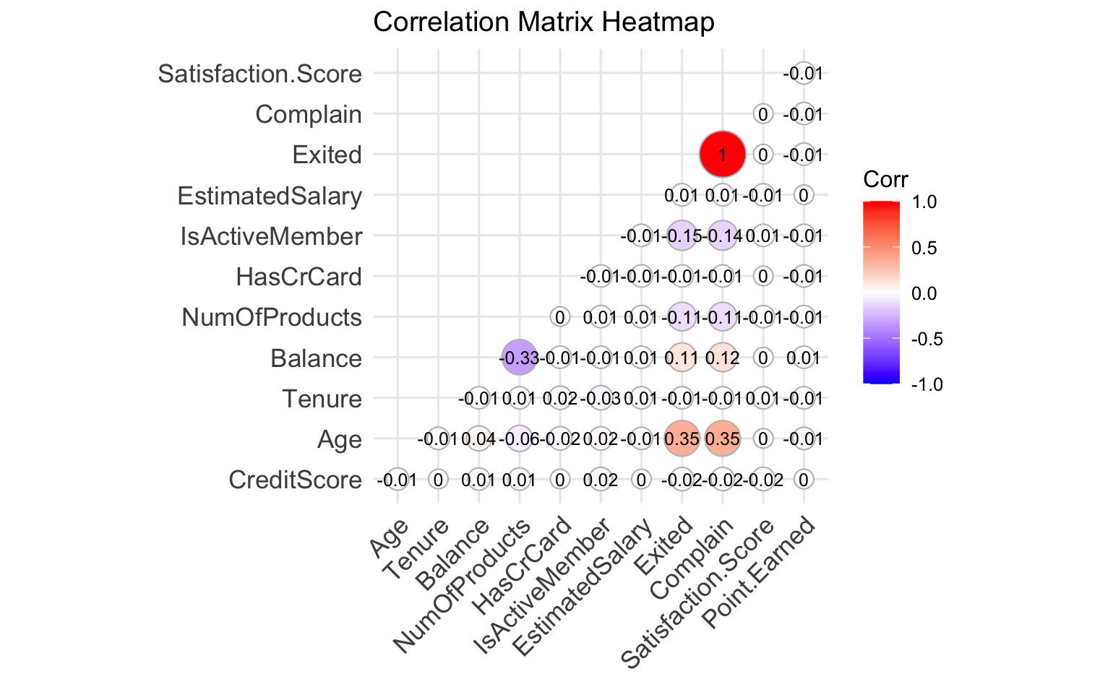
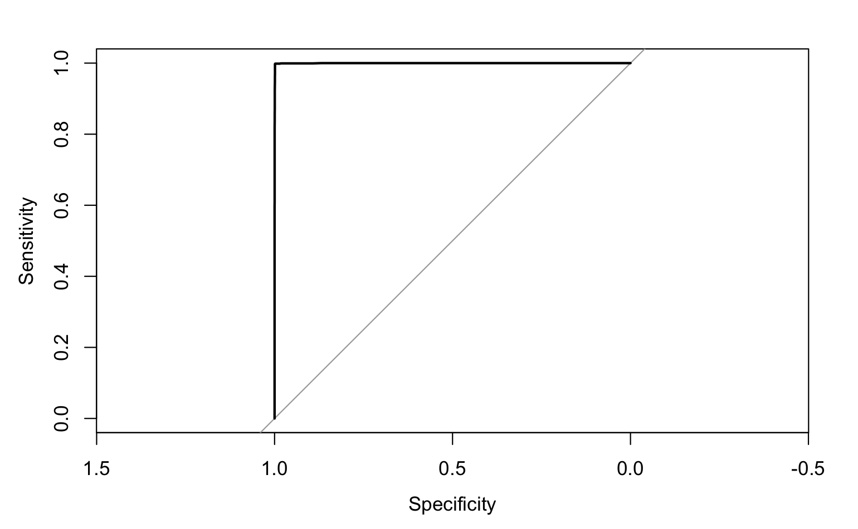
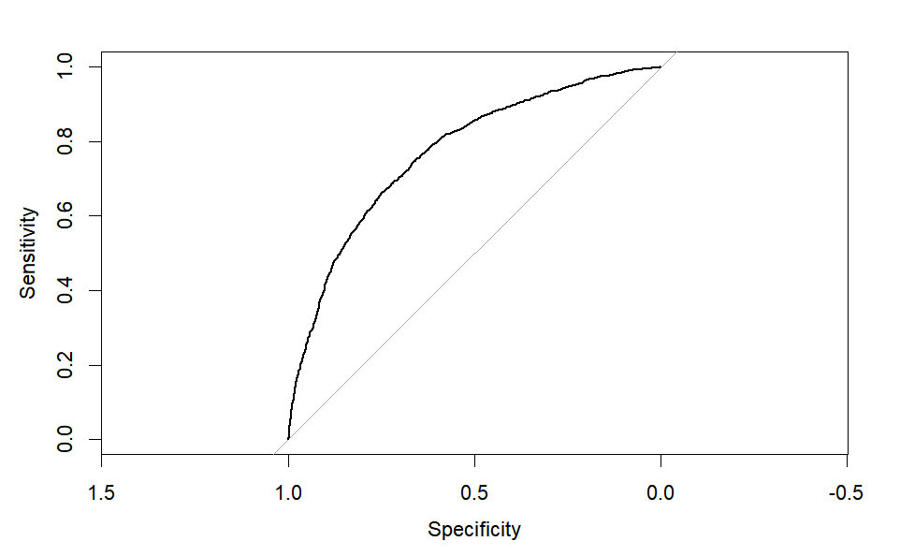
Complain
We removed the variable 'complain' from our analysis as it showed a high correlation with the target variable 'exited', which led to overfitting issues.
Group 9
Mercer University
11/12
Notes:
1st image (left) with the complain variable – overfitting 99.8% accuracy
2nd image (right) remove complain variable because it will highly correlated to exited (target variable)

Slide 10
Model Stats
Algorithm | Accuracy | Sensitivity | Specificity | AUC
Logistic | 71.7 | 73.50 | 69.87 | 79.59
CART | 79.73 | 81.89 | 71.21 | 83.22
RF | 83.8 | 89.26 | 62.24 | 85.48
KNN | 83.53 | 68.41 | 98.96 | 83.68
Group 9
Mercer University
9/12
Notes:
We used accuracy

Slide 11
Results
RF | MeanDecreaseAccuracy | MeanDecreaseGini
Age | 109.97 | 1018.36
Balance | 59.36 | 393.54
NumofProducts | 59.67 | 553.83
Logistic Model | Estimated Coefficient | P-Value
Age | 1.092e-01 | <2e-16***
Balance | 2.761e-06 | 1.37e-11***
NumOfProducts | -2.691e-01 | 1.26e-12***
Group 9
Mercer University
9/12
Notes:
Using importance function in Random forest
MDA is often looked as part of feature importance plot to help identify the most influential in the dataset.
MDG also know as Gini Importance, is measure of feature importance used in Random Forest models. It is based on the Gini impurity criteion, which is commonly used for splitting nodes in decision trees.
Logistic:
Age
Tenure
Balance
NumOfProducts
IsActive member
Point.Earned
Geography_Germany
Geogrpahy_ Spain
Card.Type_Gold
Card.Type.Sliver
Gender_Male

Slide 12
Business recommendations
Age: As age increases the log odds of leaving increases, age is a continuous variable. As age increases the customer is 2.98 times more likely to exit. We can offer restaurant, groceries, and travel rewards to those customers
Balance: As balance increases the log odds of leaving the bank increases. A customer is 15.81 more times likely to exit. To prevent customers from leaving the bank, the bank will could offer extra rewards for every three months that are paid off earlier.
NumofProducts: Customer with a higher number of products through the bank are approximately 6.78 times less likely to churn compared to those without such a plan. We can offer customers to pick industry of their liking to earn double to points for each month.
Group 9
Mercer University
12/12
Notes:
Age: is 2.98 more time more likely to exit
Balance: 15.81 more times more likely to exit

Slide 13
Conclusion
After running various models, we conclude that the best model is the Random Forest model.
We reviewed the importance factor to determine the variables that are most important in affecting customer churn.
We have provided business recommendations accordingly.
Group 9
Mercer University
12/12
Notes:
1st image (top- left) -logistic model
2nd image (bottom left) -
3rd image (top right ) -
4th image (bottom right) -

Slide 14
Thank you! Questions?
Group 9
Mercer University
12/12
Notes:
1st image (top- left) -logistic model
2nd image (bottom left) -
3rd image (top right ) -
4th image (bottom right) -

Slide 15
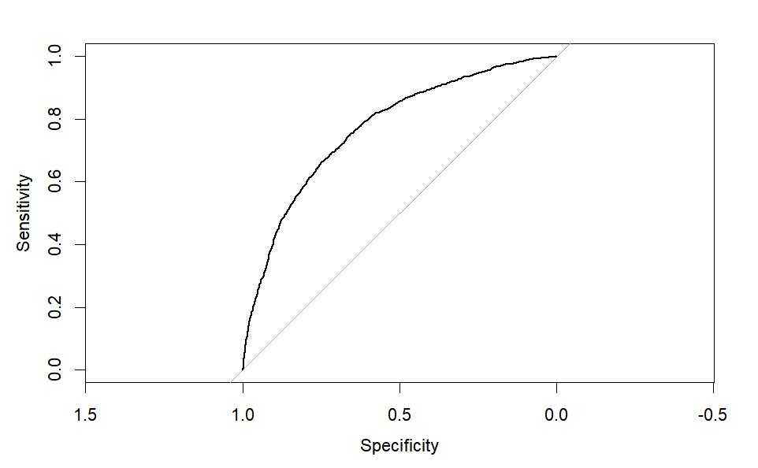
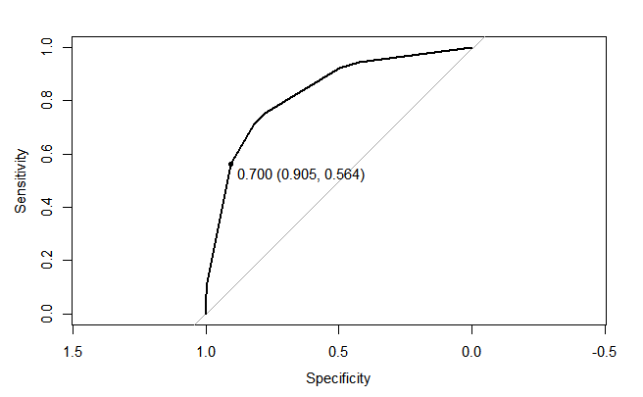
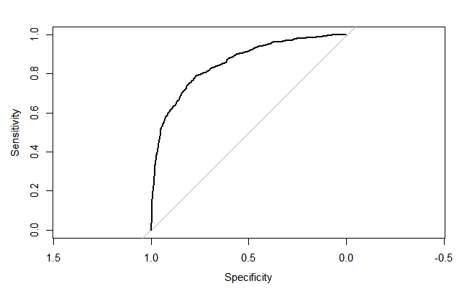
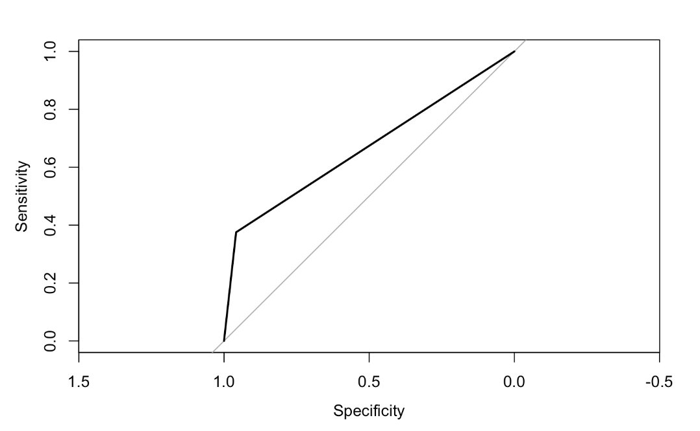
Appendix 1: ROC AUC with different models
CART
LOG
RF
KNN
Group 9
Mercer University
12/12

Slide 16
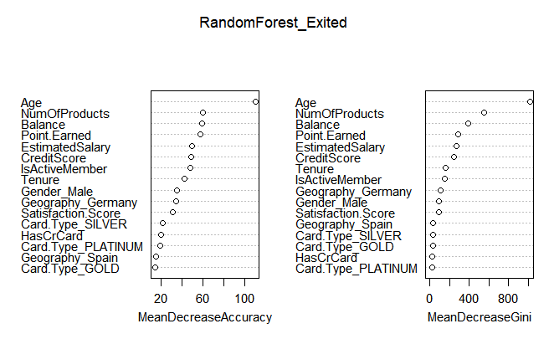
Appendix 2: Random Forest Importance
Group 9
Mercer University
12/12
Notes:
4th image (bottom right) -

Slide 17
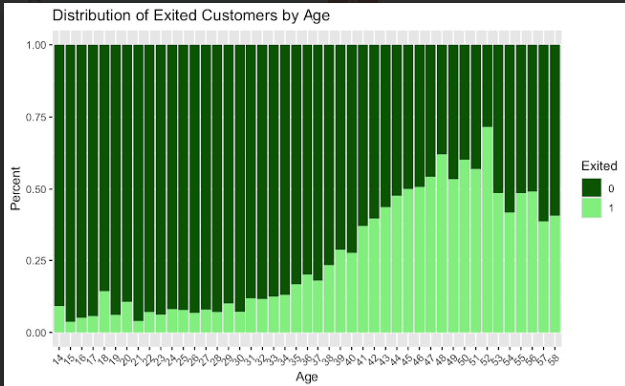
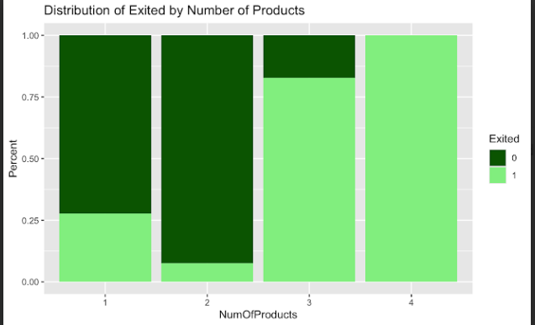
Appendix 3: Age and Products
Group 9
Mercer University
12/12

